Slide 1
Procedural Pearls
A quick nonsurgical treatment

Slide 2
Solesta Kit Content¹
4 Syringes: Solesta is supplied in a disposable 1 mL assembled glass syringe with a standard Luer-lock fitting
4 Needles: SteriJect®, 21G x 4 ¾ inches, 0.80 x 120mm
Patient Record Labels
Instructions for Use
Procedural Tools
Important¹
Store at a temperature up to 25°C (77°F) and protect from sunlight and freezing temperatures
Product is for single use. Do not use if damaged.
Solesta Package Insert. Santa Barbara, CA: Palette Life Sciences

Slide 3
Side view anoscope with obturator
Maneuverable light source
Lubrication
Long swabs
Gloves
Gauze
Solesta x 4 mL
4 Solesta needles
Extra Solesta kit on hand
Important: The light source should be maneuverable to illuminate the area of injection during patient movement and sequential mucosa change.
Equipment¹
1. “Physician training and certification video.” Training and certification for administering Solesta, Palette Life Sciences, Inc., www.mysolesta.com/solesta-training-and-certification.

Slide 4
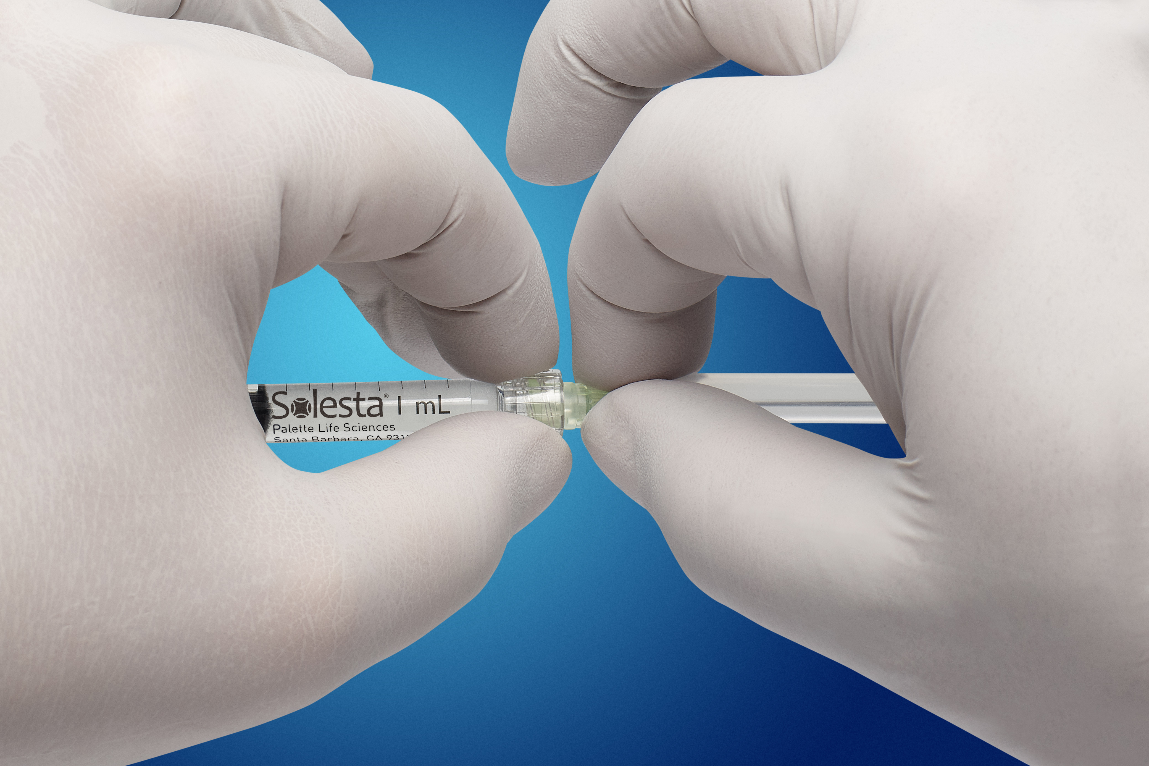
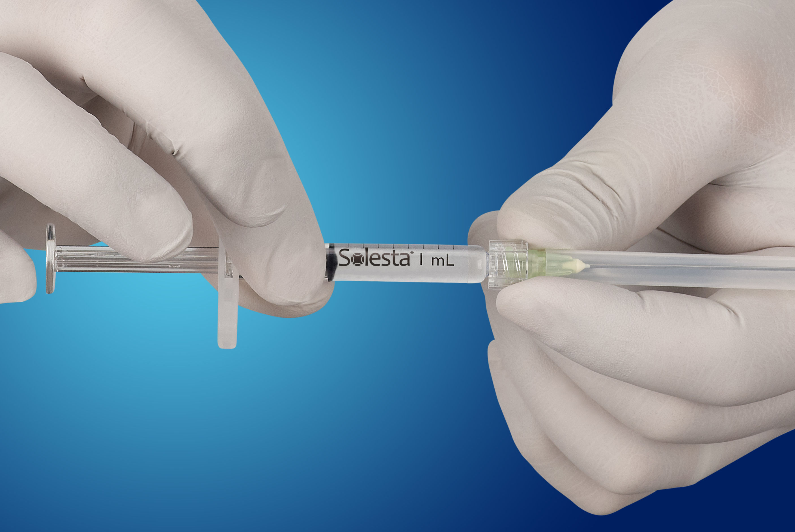
Syringe Preparation
4 Solesta syringes should be assembled ahead of procedure, under aseptic conditions
Assemble all 4 syringes prior to patient procedure¹
Thumb and forefinger should be held firmly around the Luer-lock adapter of the glass syringe¹
DO NOT attach the needle by holding onto the glass barrel of the syringe¹
Firmly push and rotate the needle hub into the Luer-lock adapter¹
Slowly prime the needle until a small bead of Solesta appears at tip of needle²
Important: The Luer-lock adapter is snapped onto the syringe and held in place with friction only. It can rotate freely or be pulled off should enough force be applied¹
→ Correct
→ Incorrect
Solesta Package Insert. Santa Barbara, CA: Palette Life Sciences
“Physician training and certification video.” Training and certification for administering Solesta, Palette Life Sciences, Inc., www.mysolesta.com/solesta-training-and-certification.

Slide 5

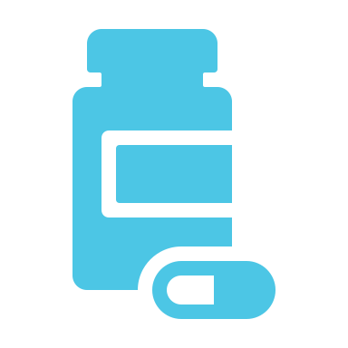

Patient Preparation
Bowel Preparation
Description
Description
Medication
Area Preparation
Prepare the rectum using an enema immediately prior to procedure¹
Frequently, your initial font choice is taken out of your awesome hands also we are companies.
Frequently, your initial font choice is taken out of your awesome hands also we are companies.
Clean injection area with an antiseptic¹
Prophylactic antibiotics are recommended¹
Talk patients through each step of injection²
Solesta Package Insert. Santa Barbara, CA: Palette Life Sciences
“Physician training and certification video.” Training and certification for administering Solesta, Palette Life Sciences, Inc., www.mysolesta.com/solesta-training-and-certification.

Slide 6


Patient Positioning
Physician Visualization May be Better From a Sitting Position
Left Lateral Position¹
Jackknife Prone Position¹
Graf W, Mellgren A, Matzel KE, et al. Efficacy of dextranomer in stabilized hyaluronic acid for treatment of faecal incontinence: a randomized, sham-controlled trial. The Lancet. 2011;377:997-1003.

Slide 7
Injection Pearls
A side view lubricated anoscope should be used for visibility. Anoscope should be removed, obturator replaced, rotated 90° and reinserted with each injection to avoid tissue capture¹
Under direct vision, approximately 30° to the axis of the rectum, puncture the mucosa with the bevel of the needle facing the lumen of the rectum, 5 mm proximal to the dentate line²
If the patient indicates pain at the puncture, the injection site should be adjusted a few mm in the cephalic direction²
If the puncture is painless, advance the needle further 5 mm approximately 30° to the axis of the rectum²
  Injections too close to the dentate line or at a depth greater than 5 mm may cause pain and/or lack of efficacy
The injections should be performed slowly with constant pressure to avoid stress on the Luer-lock connection and allow the tissue to adapt to the injected gel²
The four equally spaced injections are to be given in the following order²
  Posterior 2) Left Lateral 3) Anterior 4) Right Lateral
Important: Injection should be stopped if excessive bleeding or pain occurs²
Procedural Pearls
“Physician training and certification video.” Training and certification for administering Solesta, Palette Life Sciences, Inc., www.mysolesta.com/solesta-training-and-certification.
Solesta Package Insert. Santa Barbara, CA: Palette Life Sciences

Slide 8
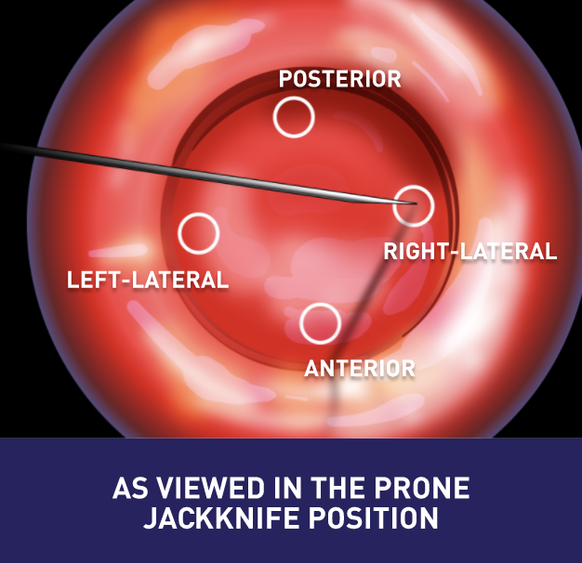
Injection Pearls
The four equally spaced injections are to be given in the following order¹
  Posterior
  Left Lateral
  Anterior
  Right Lateral
Solesta Package Insert. Santa Barbara, CA: Palette Life Sciences

Slide 9

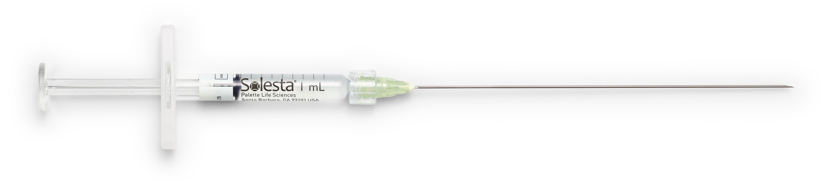
Needle Pearls
A new needle should be used for each syringe and injection site¹
The needle should be kept in position for 15-30 seconds to minimize leakage of Solesta¹
There is a triangular mark on the needle hub that provides the orientation of the needle bevel to ensure the bevel is facing the lumen when needle is inserted¹
The bevel of the needle opening is 2 mm long²
Procedural Pearls
Solesta Package Insert. Santa Barbara, CA: Palette Life Sciences
“Physician training and certification video.” Training and certification for administering Solesta, Palette Life Sciences, Inc., www.mysolesta.com/solesta-training-and-certification.

Slide 10
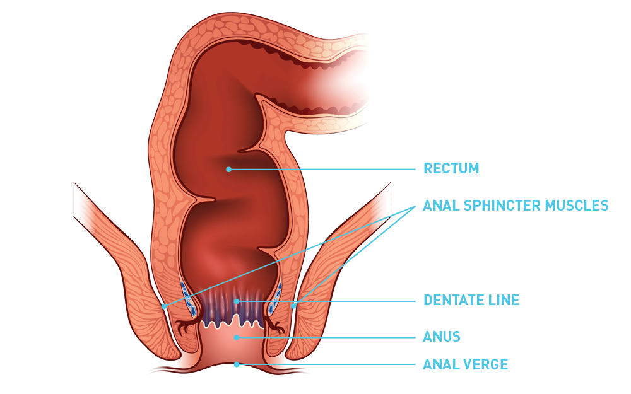
During Injection
The dentate line can vary due to anatomical variation, age, disease or overlapping rectal mucosa²
The general area of injection is about 2 cm from the anal verge²
If the patient feels pain, move the needle cephalad and proximal (towards the head and center) until no pain is reported¹
Bleeding may be stemmed with direct firm pressure and a long surgical swab²
Visualization
Solesta Package Insert. Santa Barbara, CA: Palette Life Sciences
“Physician training and certification video.” Training and certification for administering Solesta, Palette Life Sciences, Inc., www.mysolesta.com/solesta-training-and-certification.

Slide 11
After Injection
A pillowing or slight bulging effect beneath the submucosal layer may be seen¹
When properly placed submucosally, lack of 4 distinct bulges does not hinder effectiveness or indicate the injection was not performed correctly¹
Hemorrhoids
Visualization
Hemorrhoidal tissue is blue and bulging in appearance; mucosal tissue is pink and flat
Inject superior or lateral, adjacent to the hemorrhoids and not into them¹
“Physician training and certification video.” Training and certification for administering Solesta, Palette Life Sciences, Inc., www.mysolesta.com/solesta-training-and-certification.

Slide 12
Immediately after the procedure, the patient should rest at the clinic for 60 minutes
If no bleeding or other treatment-related symptoms are observed during this time, the patient may leave
Stool softeners may be used until the first defecation occurs
Analgesics other than nonsteroidal anti-inflammatory drugs (NSAIDs) may be prescribed, if needed
Inform of the risk of infection and bleeding
The patient should be instructed to avoid:
  Hot baths during the first 24 hours
  Physical activity for 24 hours
  e.g., horseback riding, bicycling and jogging, etc.
  Anti-diarrheal drugs for 1 week
  Sexual intercourse for 1 week
  Anal manipulation for 1 month
  e.g., insertion of suppositories or enemas and rectal temperature recording
Patient should contact the clinic or physician’s office immediately if symptoms of rectal bleeding, bloody diarrhea, fever, tenesmus or problems with urinating occur.
Post-Procedural Instructions¹
Solesta Package Insert. Santa Barbara, CA: Palette Life Sciences

Slide 13
No sooner than 4 weeks after the first injection
If the patient does not have an adequate response to Solesta after the first injection, a re-injection with a maximum of 4 mL Solesta can be performed
Pre-treatment preparation and post-procedure patient instructions are the same
Procedure technique is the same, except the point of injection should be made in between the initial injections, shifted one-eighth of a turn (left posterolateral, left anterolateral, right anterolateral, and right posterolateral)
Solesta is an injectable outpatient product for the treatment of fecal incontinence in patients 18 years and older who have failed conservative therapy (e.g. diet, fiber therapy, antimotility medications, pelvic floor exercises (Kegels), biofeedback).
Re-treatment¹
Solesta Package Insert. Santa Barbara, CA: Palette Life Sciences.

Slide 14
For more information on Solesta or to be certified in the Solesta Treatment, please visit MySolesta.com
For product information, adverse event reports, and product complaint reports, contact:
Palette Life Sciences
Medical Information Department
Tel 844.350.9656
Fax 510.595.8183
Email palettemc@dlss.com
© 2020 Palette Life Sciences, Inc. Solesta® is a registered trademark. All rights reserved. APM052B

